Slide 1
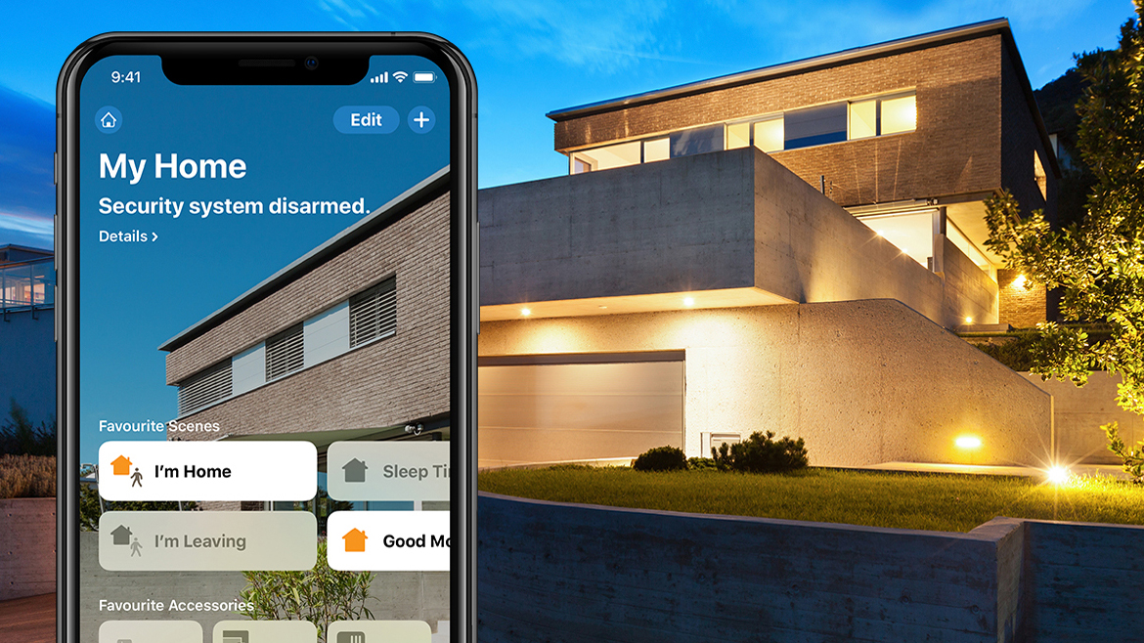
Home Security System
Fedy Haj Ali
Daniela Koreta
Real-Time Embedded Systems
A.A. 2020-2021

Slide 2
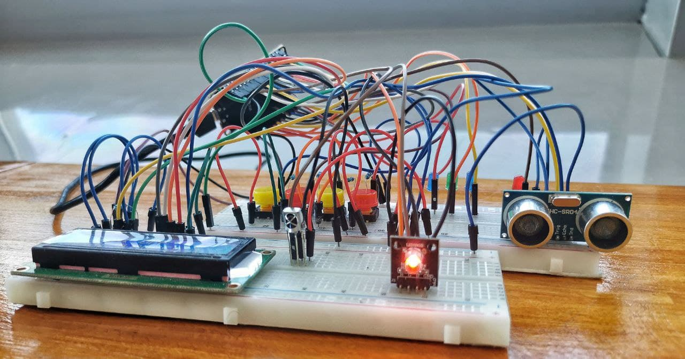
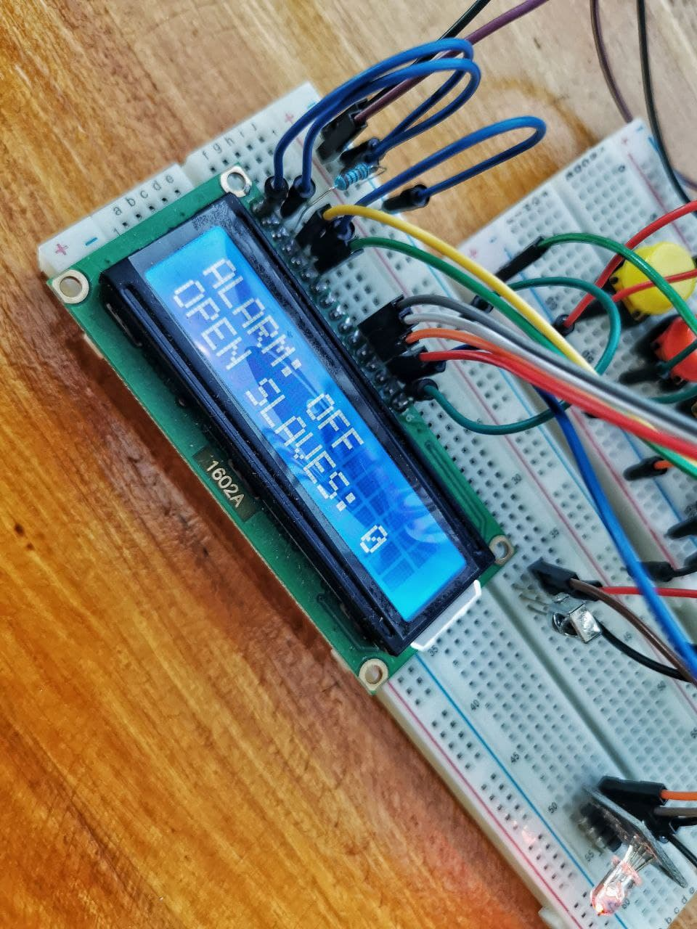
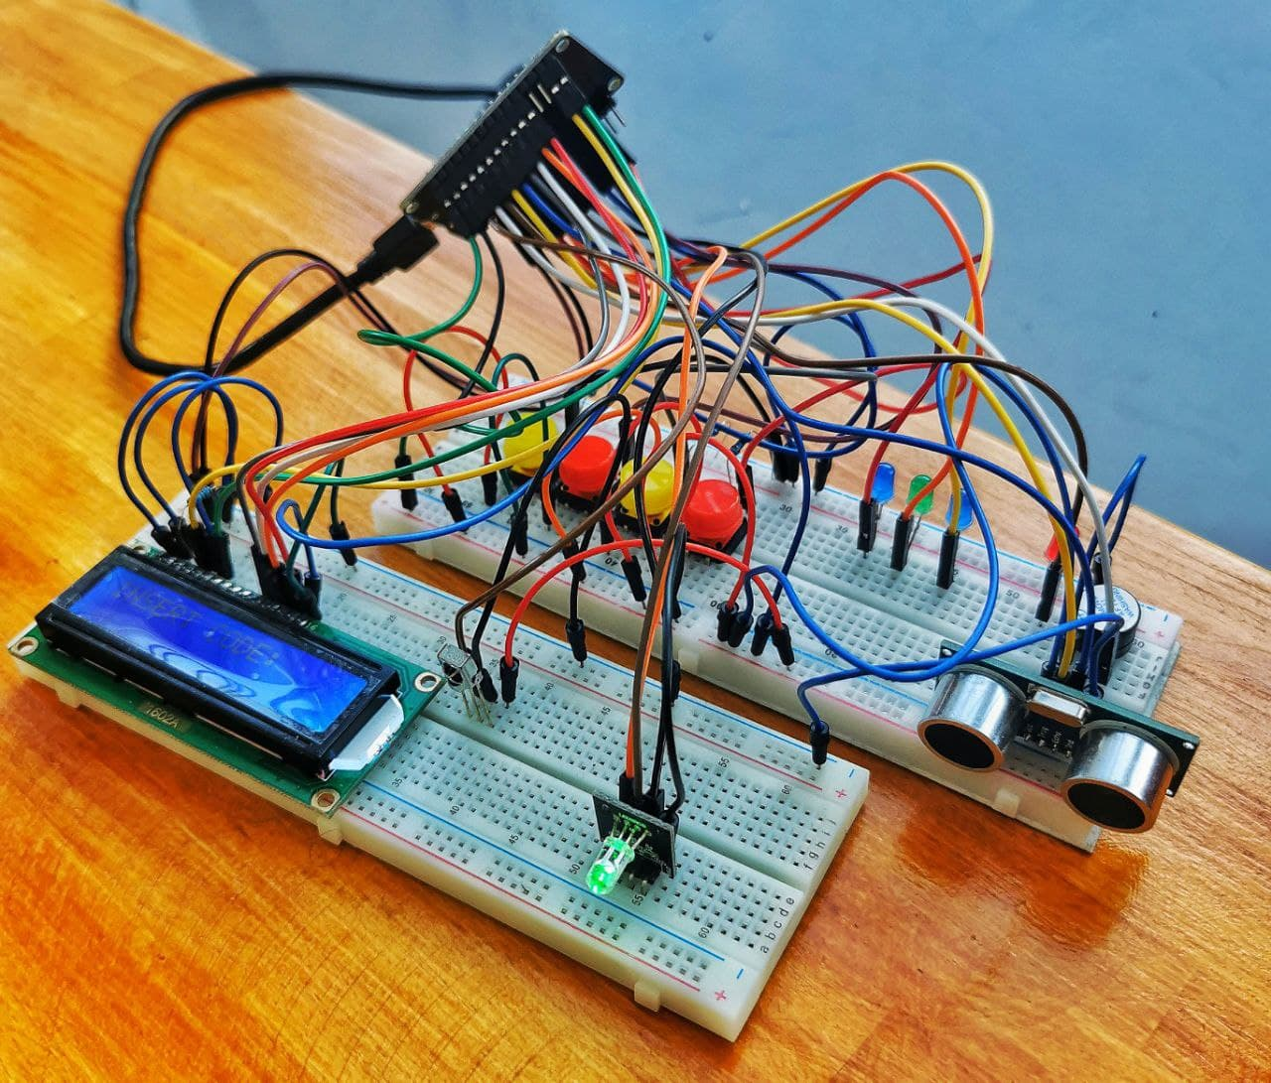
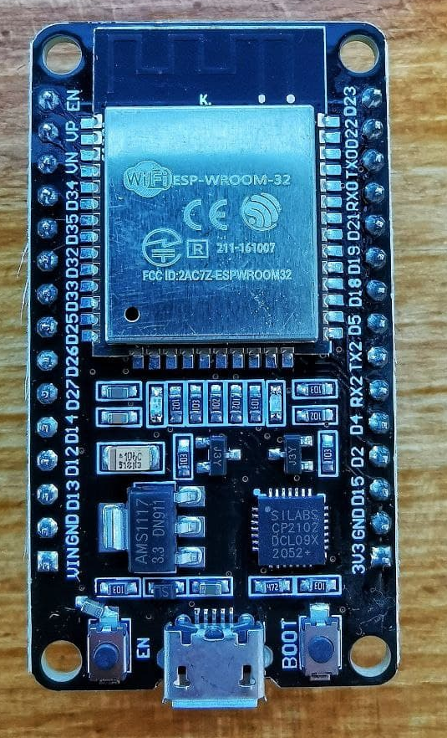
Introduction
Realization
Application
Requirements
Conclusions
About This Project

Slide 3








Introduction
Realization
Application
Requirements
Conclusions
Software Tools

Slide 4
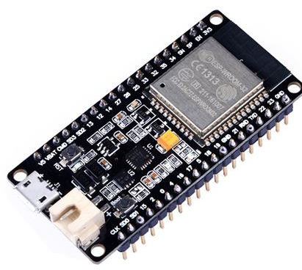
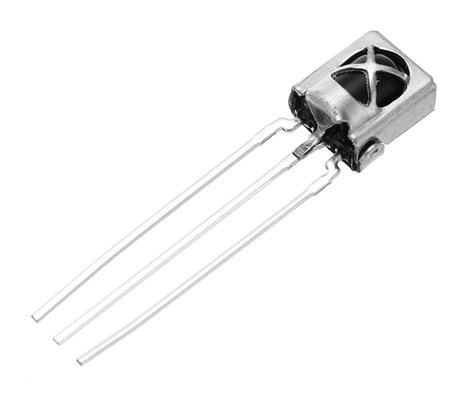
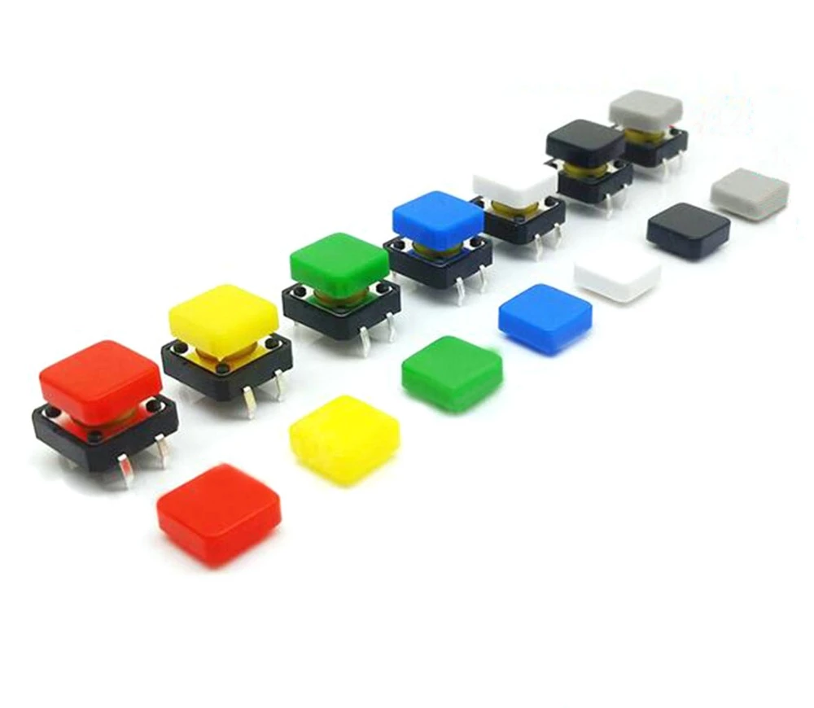
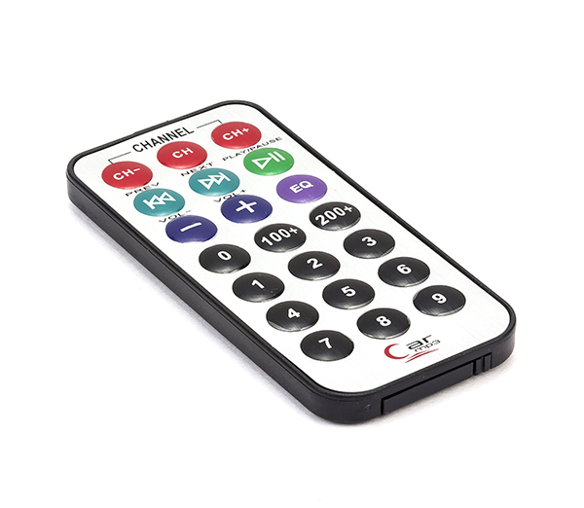

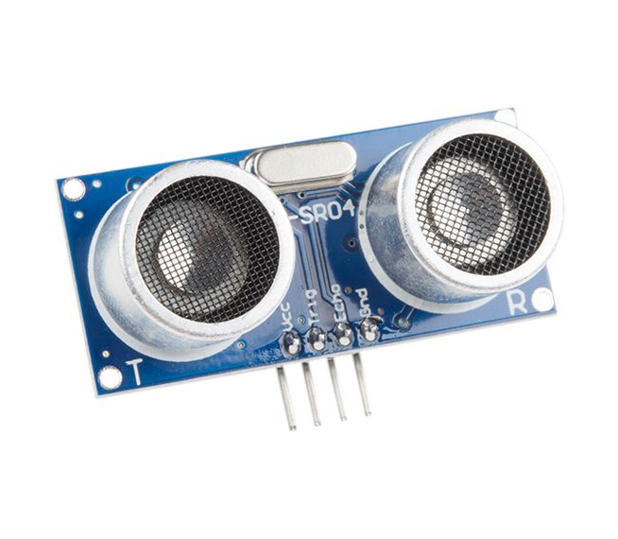
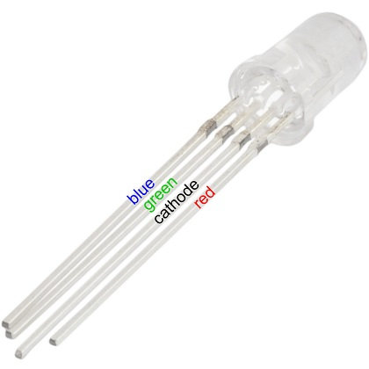
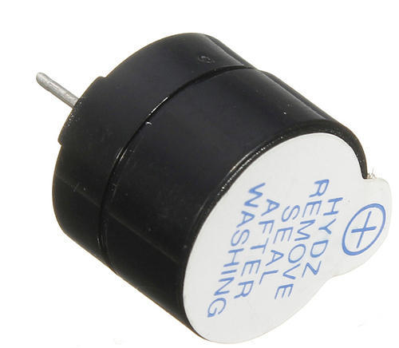
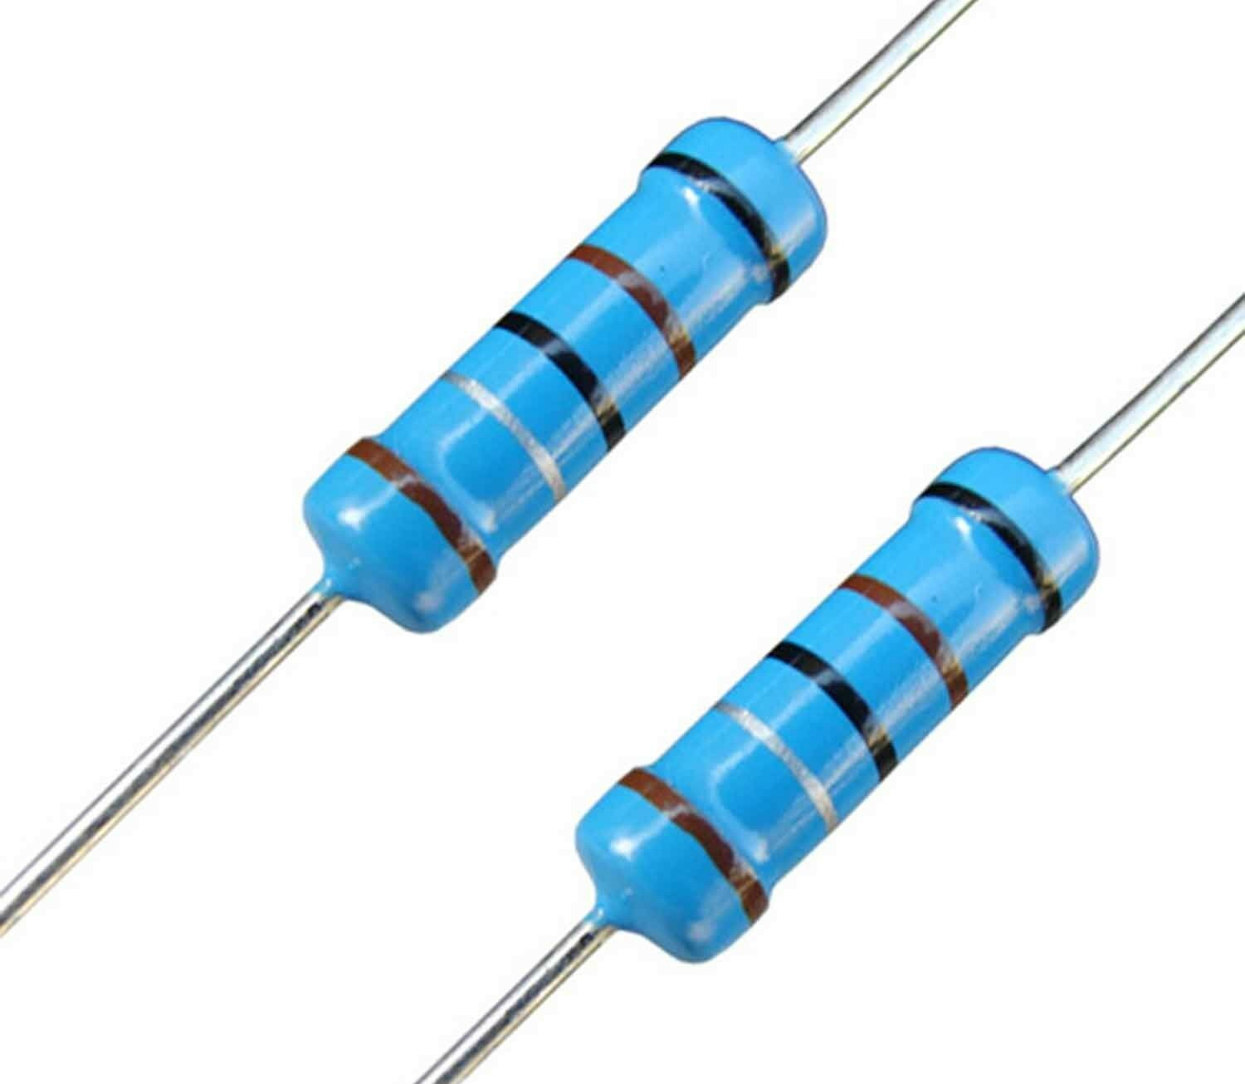
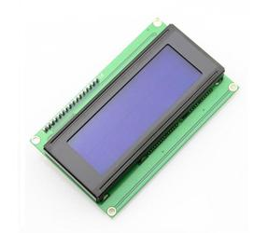
Introduction
Realization
Application
Requirements
Conclusions
Hardware Components
esp32
infrared receiver
buttons
remote control
leds
ultrasonic sensor
led RGB
buzzer
resistors
display LCD

Slide 5
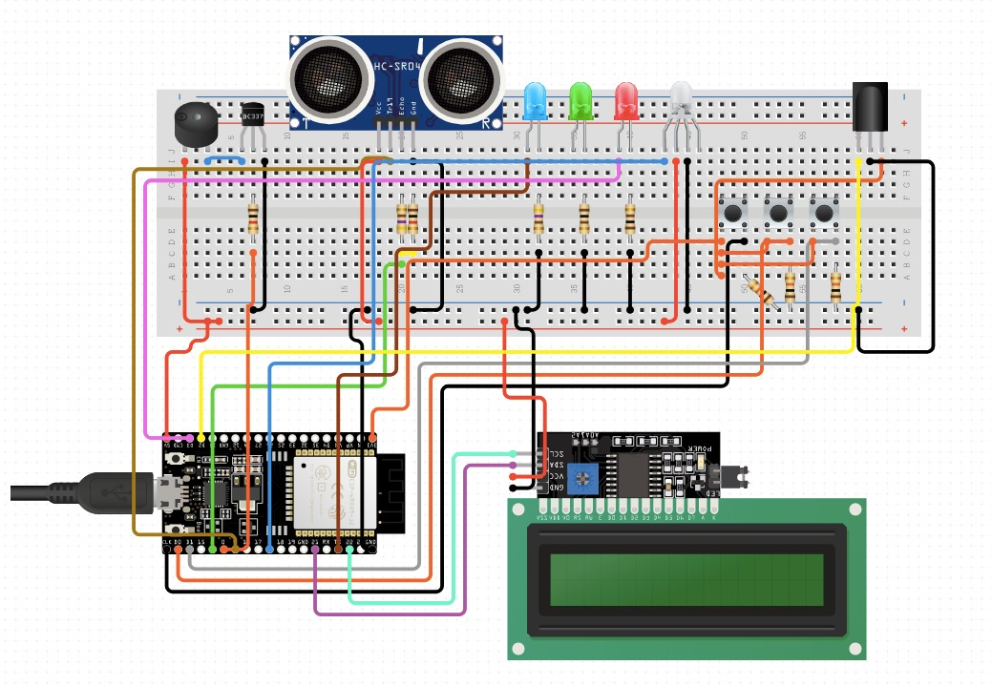
Introduction
Realization
Application
Requirements
Conclusions
Circuit Schematics

Slide 6
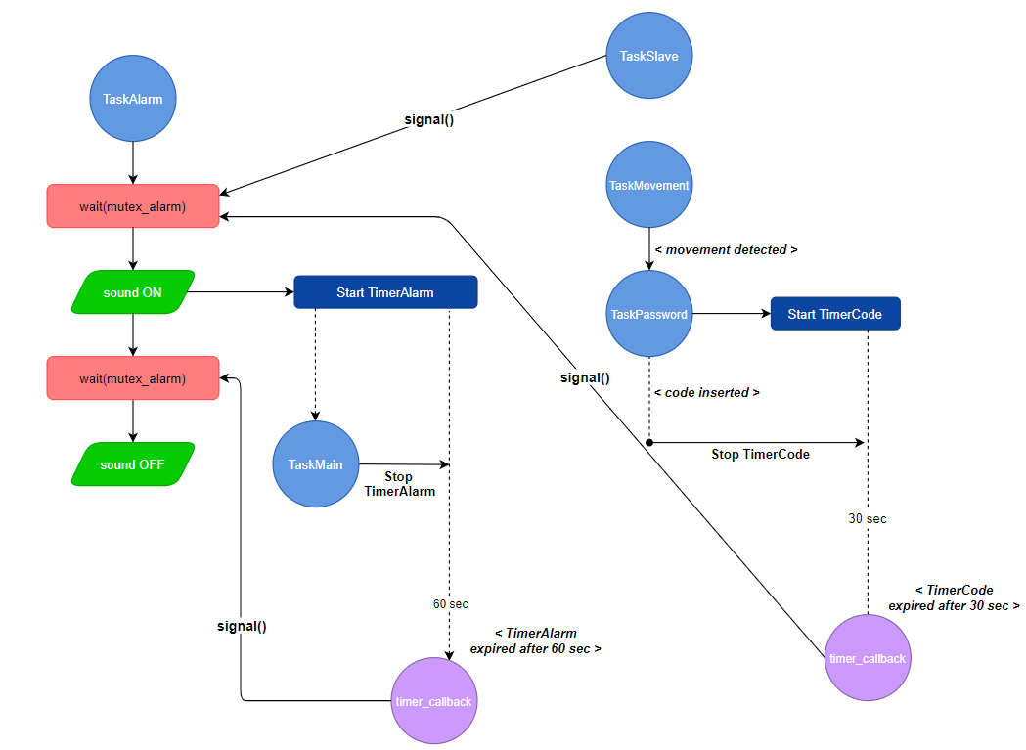
Introduction
Realization
Application
Requirements
Conclusions
Syncrhonization

Slide 7
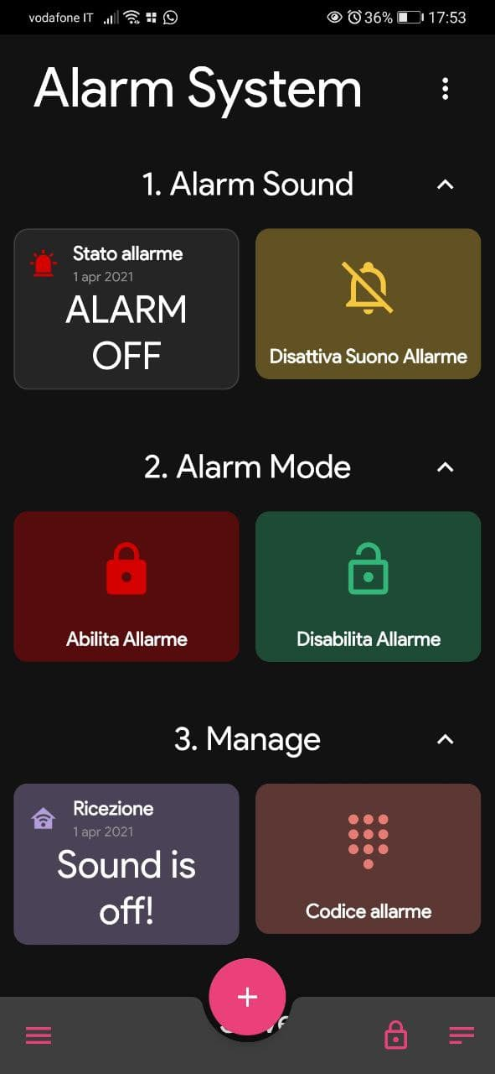
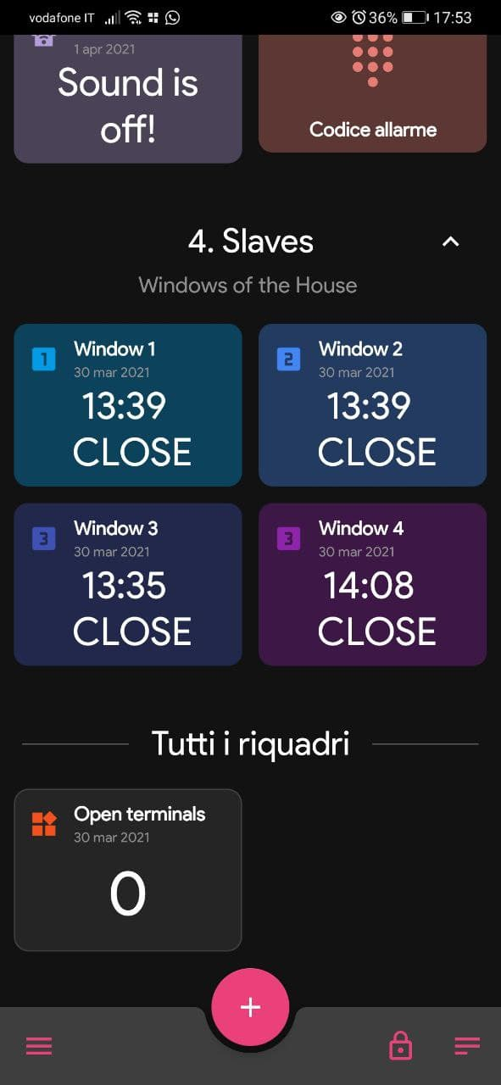
Introduction
Realization
Application
Requirements
Conclusions
MQTT

Slide 8

Introduction
Realization
Application
Requirements
Conclusions
Application Requirements
Channels:
1x ultrasonic sensor, 3x buttons, 4x leds, 1x buzzer, 1x infrared receiver
1 task per input/output channel:
TaskMovement, TaskDisplay, TaskAlarm, TaskSlaves,
TaskSetAlarmButton, TaskPassword, TaskMain
≥ 3 input channels:
remote control, app, ultrasonic sensor, buttons
≥ 2 sensor devices or 1 sensor device + 1 network device:
infrared sensor, ultrasonic sensor, integrated Wi-Fi
≥ 2 output channels:
buzzer, app, display 16x02, leds, led RGB
≥ 1 many-to-one task communication:
communication between the Alarm System and the Application through TaskMain

Slide 9

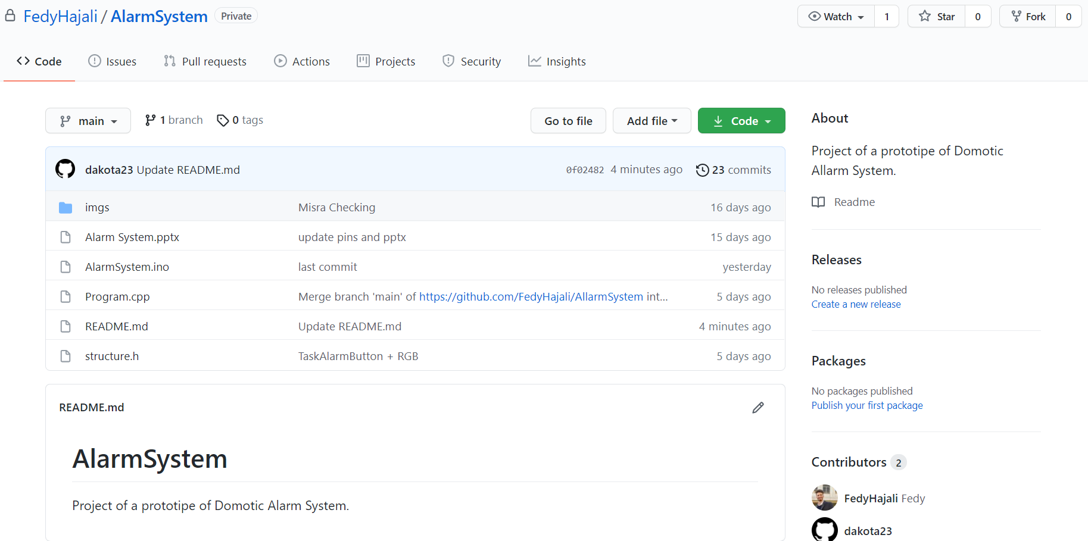

Introduction
Realization
Application
Requirements
Conclusions
Easy Requirements
Git Versioning

Slide 10
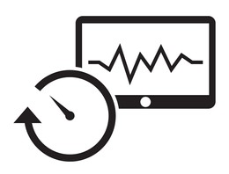
Introduction
Realization
Application
Requirements
Conclusions
Easy Requirements
Task WCET analysis measurement-based
TASK | PERIOD (ms) | WCET (ms) | CORE
TaskSlave (3) | 1000 | 4 | 0
TaskAlarm | - | - | 0
TaskSetAlarmButton | 1000 | 3 | 0
TaskMain | 1000 | 500 | 1
TaskConnection | 1000 | - | 1
TaskMovement | 2000 | 500 | 1
TaskDisplay | 2000 | 8 | 1
TaskPassword | 500 | 5 | 1

Slide 11
Introduction
Realization
Application
Requirements
Conclusions
Easy Requirements
Periodic execution (timer-based tasks)
core 0 – period 1000 ms
Slave1
Slave2
Slave3
SetAlarm

Slide 12
Introduction
Realization
Application
Requirements
Conclusions
Easy Requirements
Periodic execution (timer-based tasks)
core 1 – period 1000 ms
Main
Movement
Display

Slide 13


Introduction
Realization
Application
Requirements
Conclusions
Challenging Requirements
MISRA-C Compliance
cppcheck → analysis tool
addons → misra.py
misra.py → MISRA-C compliance validation
MISRA-C → guidelines set for embedded systems
cppcheck –addon = misra.py somefile.c

Slide 14

Introduction
Realization
Application
Requirements
Conclusions
Before
n. rule | rule description | classification | complied
2.7 | There should be no unused parameters in functions | Advisory
7.3 | The lowercase character 'l' shall not be used in a literal suffix | Required
8.11 | When an array with external linkage is declared, its size should be explicitly specified | Advisory
11.6 | A cast shall not be performed between pointer to void and an arithmetic type | Required
12.1 | The precedence of operators within expressions should be made explicit | Advisory
14.4 | The controlling expression of an if statement and the controlling expression of an iteration-statement shall have essentially Boolean type | Required
16.3 | An unconditional break statement shall terminate every switch-clause | Required
17.7 | The value returned by a function having non-void return type shall be used | Required
20.1 | #include directives should only be preceded by preprocessor directives or comments | Advisory

Slide 15

Introduction
Realization
Application
Requirements
Conclusions
After
n. rule | rule description | classification | complied
2.7 | There should be no unused parameters in functions | Advisory
7.3 | The lowercase character 'l' shall not be used in a literal suffix | Required
8.11 | When an array with external linkage is declared, its size should be explicitly specified | Advisory
11.6 | A cast shall not be performed between pointer to void and an arithmetic type | Required
12.1 | The precedence of operators within expressions should be made explicit | Advisory
14.4 | The controlling expression of an if statement and the controlling expression of an iteration-statement shall have essentially Boolean type | Required
16.3 | An unconditional break statement shall terminate every switch-clause | Required
17.7 | The value returned by a function having non-void return type shall be used | Required
20.1 | #include directives should only be preceded by preprocessor directives or comments | Advisory

Slide 16
Introduction
Realization
Application
Requirements
Conclusions
Future Improvements
BUTTONS
HC-SR04 ULTRASONIC SENSOR
ESP32
PUBLIC MQTT BROKER
WINDOW MAGNETIC SENSOR
PIR (Passive InfraRed) SENSOR
ESP32 CAM
PRIVATE MQTT BROKER

